Slide 1

SRM INSTITUTE OF SCIENCE AND TECHNOLOGY
SCHOOL OF COMPUTING DEPARTMENT OF COMPUTING TECHNOLOGIES
21CSC305P-Machine Learning Mini Project - Review 1
Handwritten Digit Recognition with SVM and Image Preprocessing Techniques
Student 1: RA2311003010677
Ushnish Ghoshal
Student 3: RA2311003010685
Divyansh Aggarwal
Student 2: RA2311003010679
Aayush Mishra
Student 4: RA2311003010691
Gautam Kumar
1

Slide 2
Abstract
This project focuses on developing a Handwritten Digit Recognition system using Support Vector Machine (SVM) as the core classification algorithm. The system leverages essential image preprocessing techniques such as grayscale conversion, noise reduction, thresholding, and feature scaling to enhance digit clarity and improve model accuracy. Using the popular MNIST dataset, the project trains the SVM model to classify digits from 0 to 9 effectively. The combination of SVM's robustness with efficient preprocessing ensures high performance in recognizing handwritten digits, demonstrating practical applications in areas like postal automation, form digitization, and OCR systems.

Slide 3
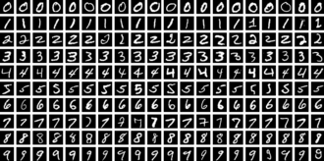
Introduction
In today’s digital era, the automation of tasks involving handwritten data has become increasingly important.
From processing application forms to digitizing archival documents, systems capable of accurately interpreting handwritten inputs can save significant time and resources.
Handwritten digit recognition is a key step in this process, enabling machines to convert human writing into machine-readable format.

Slide 4
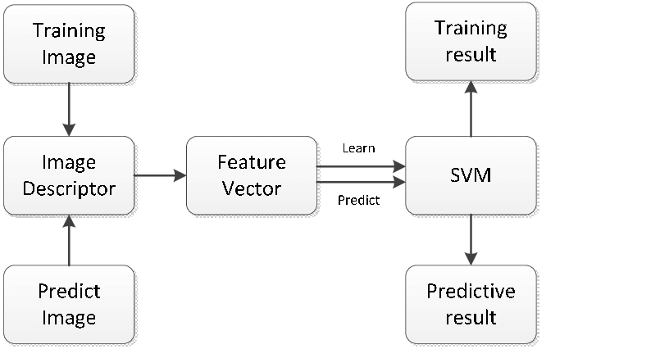
Introduction
This project explores the use of Support Vector Machine (SVM) combined with image preprocessing to achieve accurate recognition. Instead of relying solely on raw image data, the approach enhances input quality through preprocessing before classification, ensuring more reliable results.
The work highlights how the synergy of preprocessing and SVM can be leveraged for efficient and scalable recognition systems.

Slide 5
Existing System
Existing systems for handwritten digit recognition often rely on:
Convolutional Neural Networks (CNNs): Deliver high accuracy but require substantial computational resources and training time.
k-Nearest Neighbors (k-NN): Works with basic pixel features but can be slow during the prediction phase due to distance calculations.
Logistic Regression or Naïve Bayes: Offer fast training and prediction but generally result in lower accuracy compared to more advanced models.
Limitations of Existing Systems :-
High computational requirements, particularly for deep learning models like CNNs.
Sensitivity to image noise, distortions, and variations in handwriting style.
Reduced robustness when working with real-world, imperfect datasets.

Slide 6
Problem statement and Objectives
"Recognizing handwritten digits from scanned or photographed documents is challenging due to variations in handwriting style, image noise, distortions, and inconsistent image quality.“
Objectives: 🎯
To develop an SVM-based handwritten digit recognition system for digits 0–9.
To apply preprocessing techniques such as grayscale conversion, noise reduction, thresholding, and feature scaling.
To achieve high classification accuracy using the MNIST dataset.
To demonstrate the system’s practical efficiency in real-world OCR tasks such as form processing and postal automation.

Slide 7
Proposed System
The system uses Support Vector Machine (SVM) combined with image preprocessing techniques to accurately recognize handwritten digits, ensuring improved performance and robustness over traditional methods.
Key Features: ⚙️
Support Vector Machine (SVM): A robust classifier suitable for high-dimensional image data.
Image Preprocessing: Includes grayscale conversion, noise reduction, thresholding, and feature scaling to improve clarity and consistency.
Dataset: Utilizes the MNIST dataset for training and testing.
Efficiency: Delivers high accuracy while requiring less computational power compared to deep learning models like CNNs.

Slide 8
Dataset description
The MNIST (Modified National Institute of Standards and Technology) dataset is a widely used benchmark for handwritten digit recognition tasks.
📊 Dataset Details
Dataset Link: MNIST – TensorFlow Datasets
Total Samples: 70,000 images
Training: 60,000 images
Testing: 10,000 images
Classes: Digits from 0 to 9
Image Size: 28 × 28 pixels
Color Mode: Grayscale
Purpose: Standard benchmark for handwritten digit recognition tasks

Slide 9
Dataset description
Why 60,000 Training and 10,000 Test Set?
Balanced Data Source: Equal representation from both NIST sources in training & testing sets.
Training Needs: 60k images give enough variation for learning diverse handwriting styles.
Evaluation Needs: 10k images are large enough for statistically reliable performance metrics.
Data Integrity: Separate test set prevents overfitting and ensures true generalization.

Slide 10
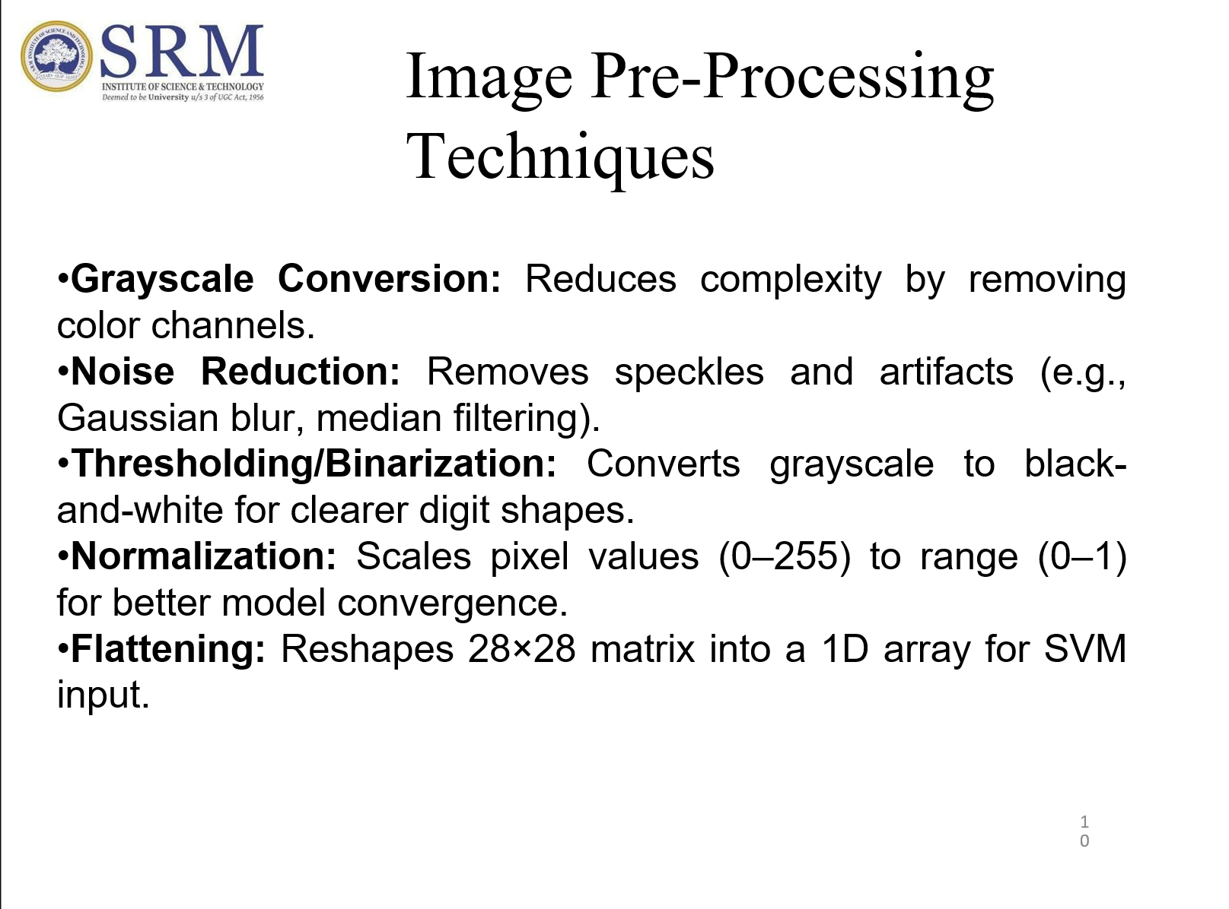

Slide 11
Statistical analysis
"The MNIST dataset is analyzed to understand the distribution of digit classes and basic image characteristics before training the model."
Key Insights: 📈
Class Distribution: Each digit class (0–9) has approximately 6,000 training samples and 1,000 testing samples, ensuring balanced data.
Pixel Intensity Range: Values range from 0 (black) to 255 (white), representing grayscale levels.
Average Intensity: Varies across digits due to differences in stroke thickness and writing styles.
Image Size Uniformity: All images are fixed at 28 × 28 pixels, simplifying preprocessing.
Balanced Dataset: Prevents model bias towards any particular digit.

Slide 12
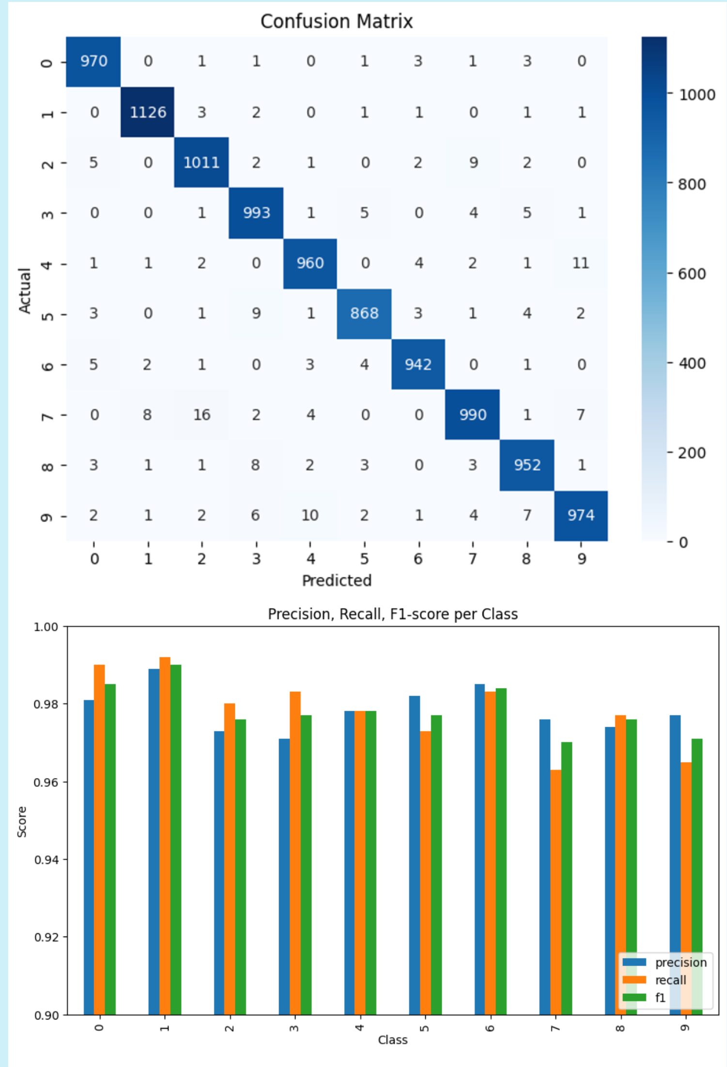
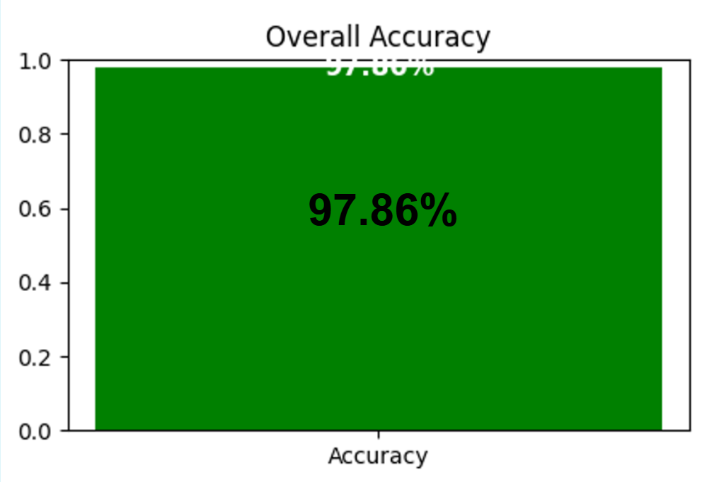
Model analysis

